Slide 1
Ontology in smart irrigation system

Slide 2
Smart Irrigation:
Smart Irrigation can be defined as the efficient use of water resources to maintain agriculture.
It is a technology-driven approach that utilizes different sensors placed in soil in irrigation systems.
It aims to improve efficiency, conserve water, and enhance plant health by applying water precisely when and where it is needed.

Slide 3
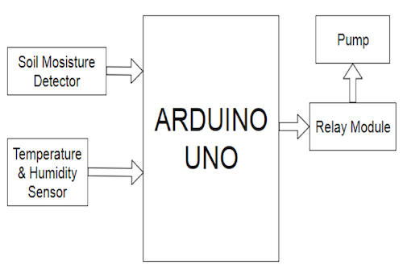
Example:
Block diagram - using sensors in irrigation system
Explanation:
As there is a soil moisture detector, it will detect moisture content in the soil and also temperature & humidity sensor, which detect the humidity in the atmosphere.
Both these are connected to Arduino uno board with a relay module and pump.
As there is less moisture content in the soil the moisture sensor detects it and the relay module will pump up the water and provide it to the plants.

Slide 4
Ontology:
Ontology is a schema where we represent knowledge and information into the machine.
It has become an increasingly important feature in smart irrigation systems.
Role of ontology in smart irrigation:
Ontology plays an important role when it comes to smart irrigation, where it helps better conclusions from any given set of data based on their relationships.
Ontologies can be used to describe the different entities, attributes and relationships within an irrigation system
Ontologies can help identify optimal soil conditions for different crops,.
It helps farmers to take decisions about which fertilizers and pesticides are most suitable for their particular needs.

Slide 5
Benefits of Ontology in smart irrigation system:
Ontology provides a structured representation of irrigation-related concepts, relationships, and rules.
Ontology-based smart irrigation systems can be easily adapted to different contexts and environments.
It increases accuracy and precision when controlling water flow rate and pressure.
It reduced costs associated with labor-intensive activities such as manually checking agricultural data or managing watering schedules .
Ontology enables intelligent reasoning and decision-making in smart irrigation systems.

Slide 6

Basic ontology on using sensors

Slide 7
Conclusion:
Ontology plays an invaluable role in improving efficiency, knowledge representation, and sustainable practices in smart agriculture.
It enables efficient data integration, supports intelligent decision-making, facilitates knowledge sharing, and promotes sustainable approaches.
By harnessing the power of ontology, smart agriculture systems can optimize resource usage, improve agricultural productivity, and contribute to a more sustainable food production system.

